Slide 1
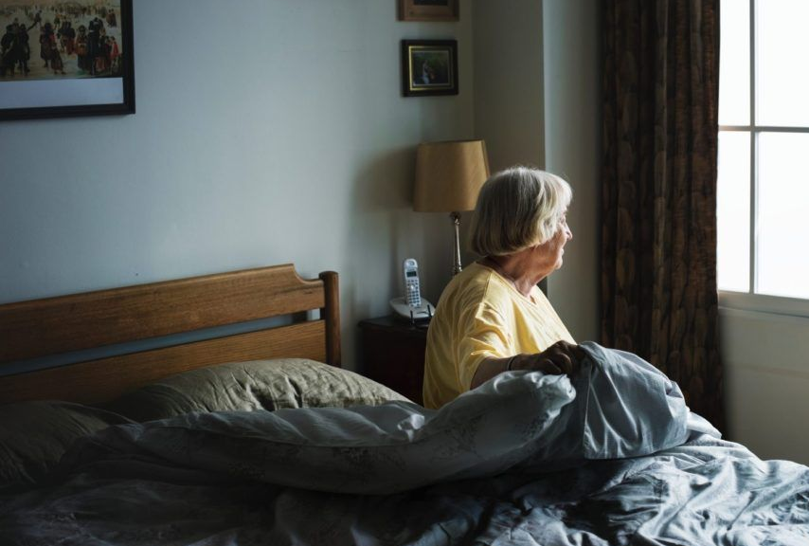
“All I ever wanted was someone to share my thoughts with, but here I am, alone and staring at a world moving around me as if I'm not even there.“

Slide 2
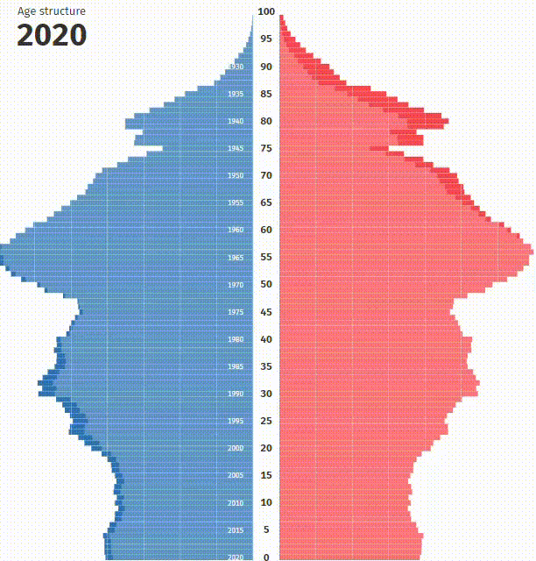
No one should age alone: we must act now!
5.2m
Lonely Elderly People
41b€
Total government spending p.a.
53%
Increased health risk

Slide 3
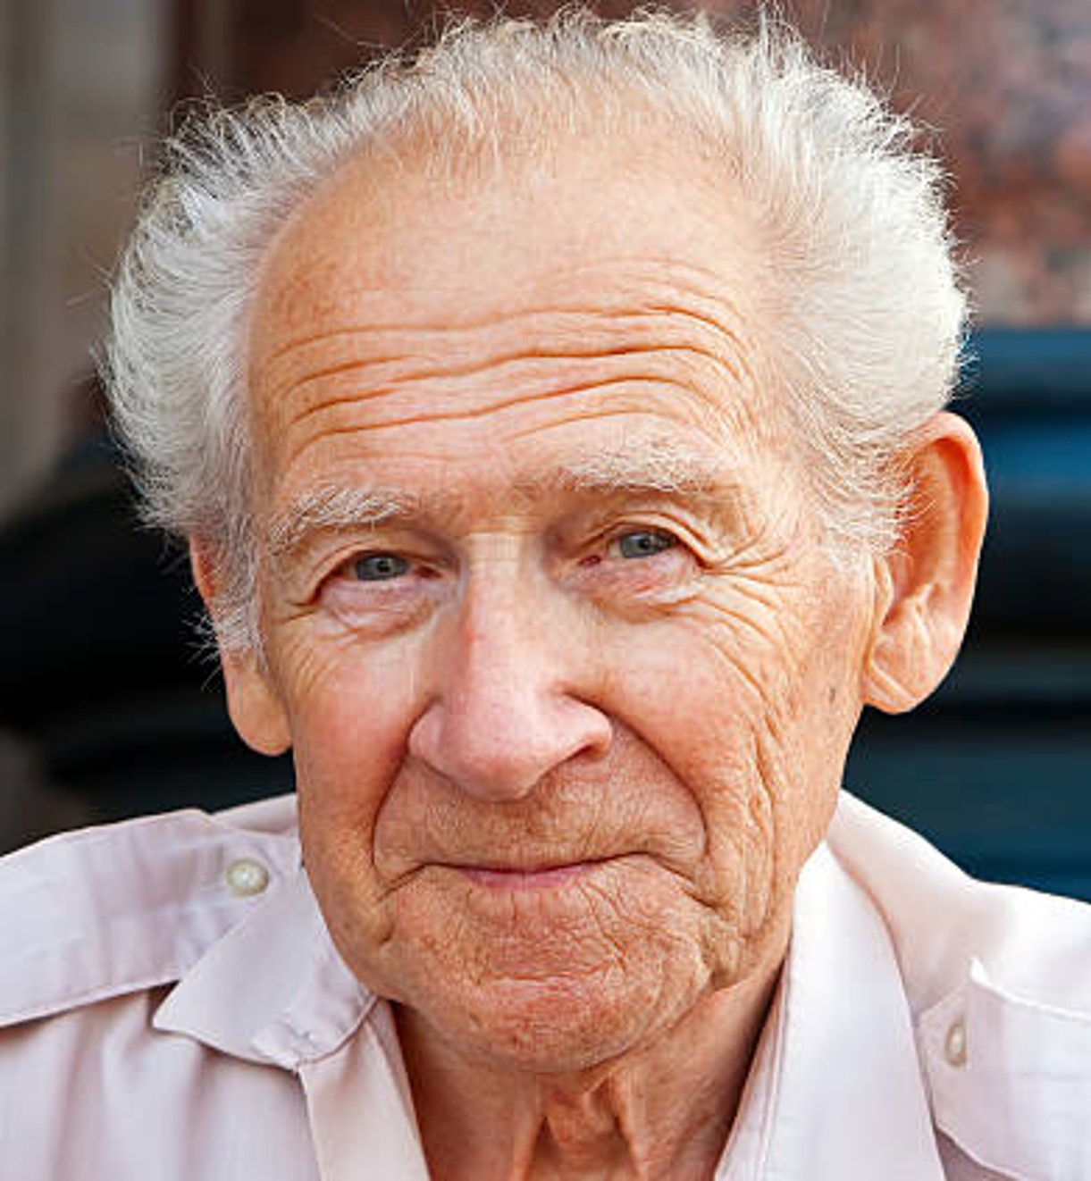
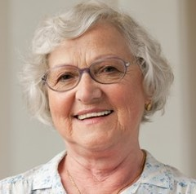
Customers
User Story: Fritz
Has 2 children and 3 grandchildren
He likes to go for a walk and watch the birds
→ The loneliness makes him grumpy
User Story: Rosalinde
Is very active and motivated
Loves to continue to challenge herself cognitively → The loneliness bores Rosalinde

Slide 4

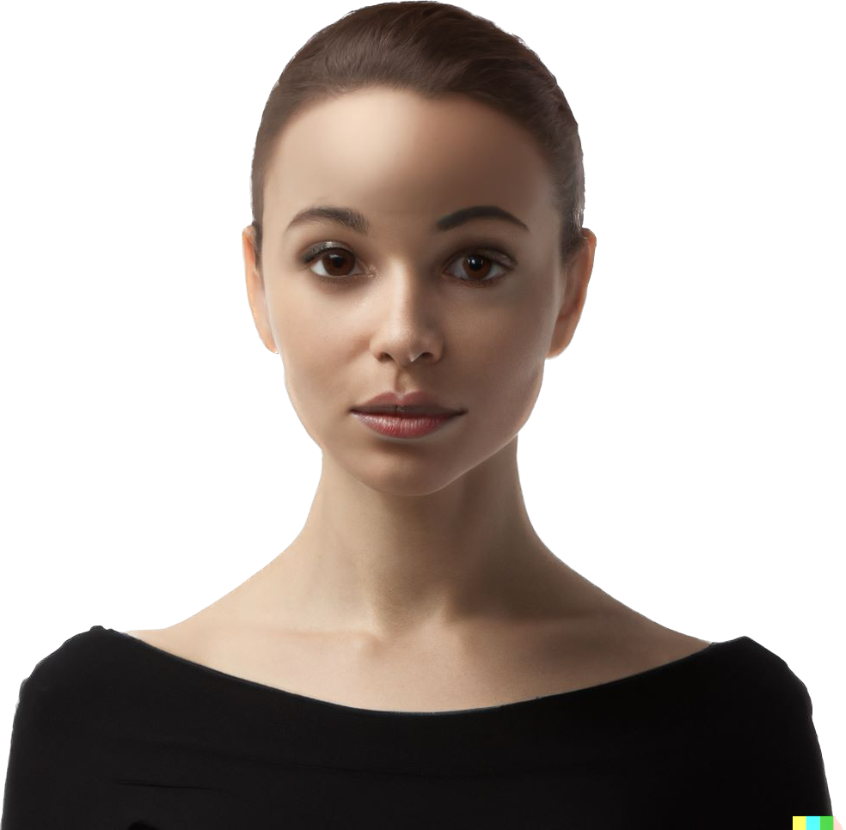

Artificial Intelligence for real-life impact!

Slide 5
Elcare: versatile features for best experience
Promoting real life interaction
Predictive Care
Personalized Content
Computer Vision
Voice Recognition
Relational Memory
Try it now!
Coming Soon!

Slide 6
Business Model: A comprehensive Solution
€16,72bn
TAM
Subscription-based Platform connecting elderly people, their families and elderly-care facilities for a monthly fee of 50€
€4,37bn
SAM
Iterative expansion of various customer groups initially within Germany all the way to cross-border commerce
€402m
SOM
Sales via Direct-to-consumer, and B2B2C via health care provider

Slide 7
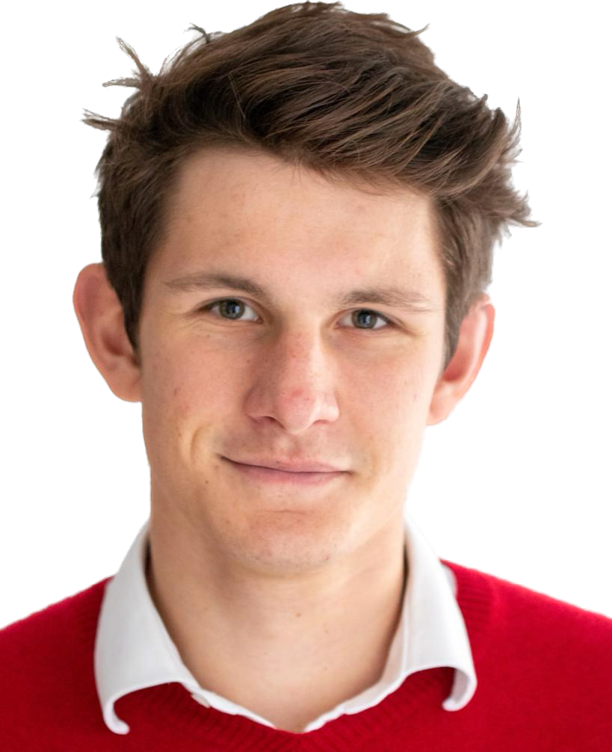
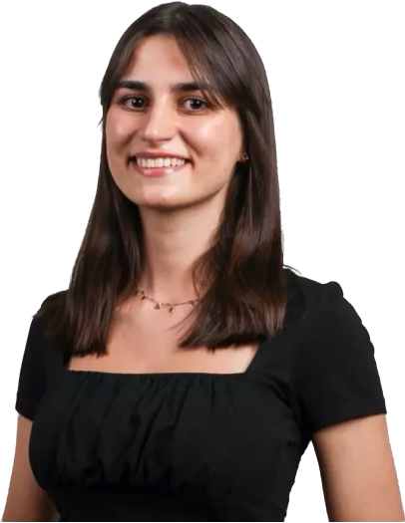
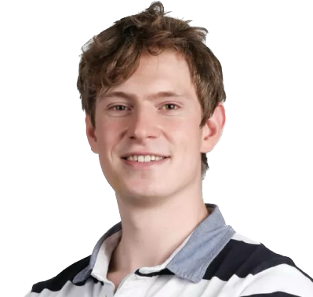
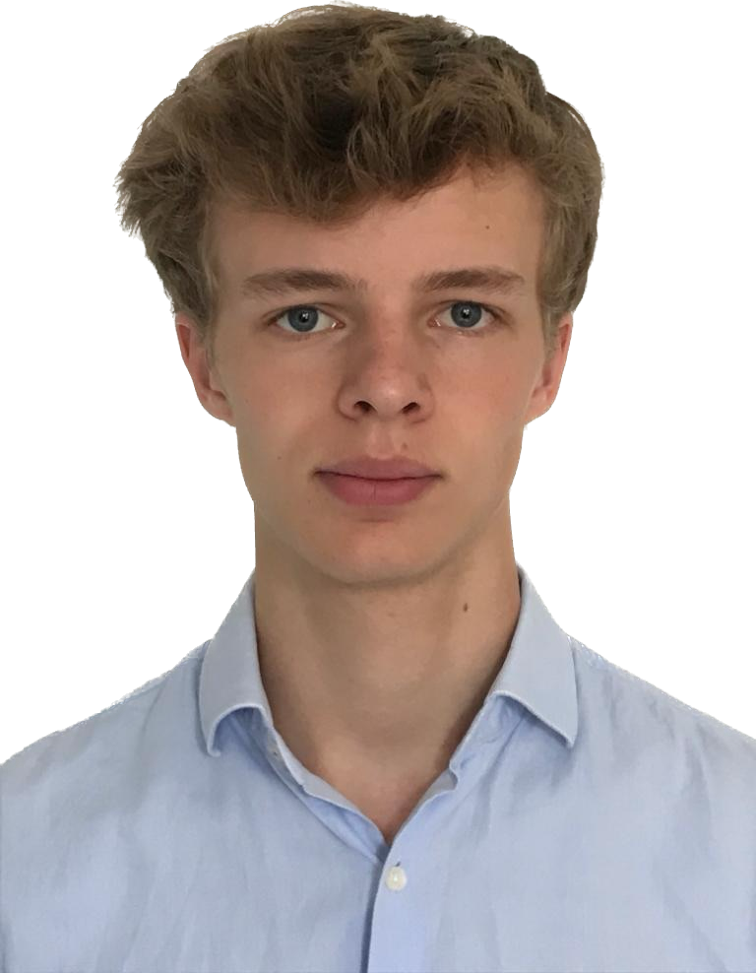






Team MostlyNaive
Benedikt Wieser
B.Sc. Business
Administration
Milana
Gurbanova
B.Sc. Management
and Technology
Leopold
Wieser
M.Sc. Electrical
Engineering
Nils
Heuer
B.Sc. Computer
Science

Slide 8
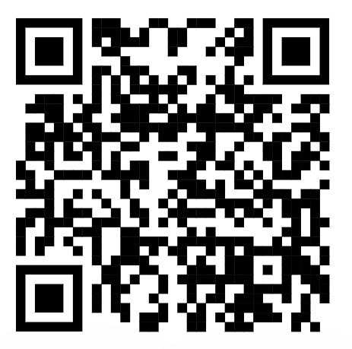
Because everybody deserves someone.

Slide 9
Innovating for the future: our road map
2022
Finalize prototype and
launch application beta
Seek co-innovation partner
Design hardware and select manufacturer
2023
Acquisition of seed-stage funding
First hires (engineers, product, sales)
Go-to-market GER & manufacturing ramp-up
2024
Product portfolio and international expansion
Launch cooperation with health care provider
Develop home care beta solution

